Slide 1
Secure Programming
程式安全
Chap 3: Static Analysis as Part of the Code Review Process
Performing a Code Review
Adding Security Review to an Existing Development Process
Static Analysis Metrics
Summary

Slide 2
Performing a Code Review
The Review Cycle
Exploitability Trap

Slide 3
The Code Review Cycle
Defining Goals
Running Static Analysis Tool
Reviewing Code
Making Fixes

Slide 4
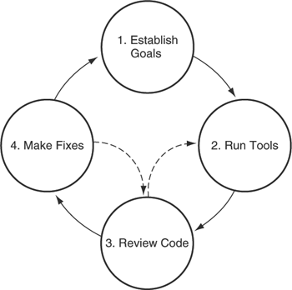
The Code Review Cycle

Slide 5
Goals
Help Prioritize the Code to be reviewed
Come from the assessment of the software risks
Example Goals
  If reachable from Internet, must be reviewed before being released
  If handle money, must be reviewed once a year
  We have cross-site scripting vulnerabilities. Stop it.

Slide 6
Run Static Analysis Tools
Get the code into compilable state
Add Custom rules to detect errors
Errors found during manual code reviews
  Previously identified error as a violation of some program invariant
    Never do X
    Always do Y
  Similar rules
Rules as institutional memory for preventing security breach

Slide 7
Review Code
Mitigating factors prevent the code from being vulnerable ?
Source of untrusted data actually untrusted ?
Scenario hypothesized by the tool actually feasible ?
If found problems not detected during step 2, return to step 2
  Write custom rules to detect other instances of the same problem and rerun the tool
  Human eye is good at for a specific instance
  Tool is good at for all instances

Slide 8
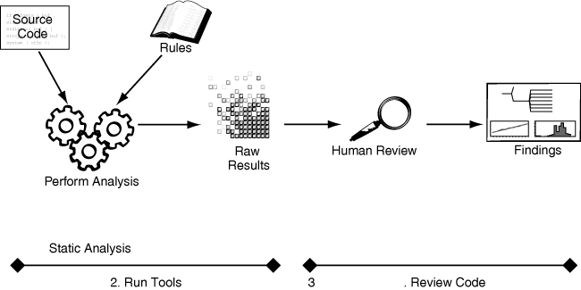
Running the tool and reviewing the code

Slide 9
Make Fixes
Competition between
  Security fixes, new functionality, bugs fixes, and making the release data
Respond to the code review
  Results from code review vs. a Failing test case
  A more complete explanation of the risk involved
Verify the fix
  If risk involved not small and changes not trivial,
    Return to the review phase
    Go back from step 4 to step 3

Slide 10
Steer Clear of the Exploitability Trap
Obviously exploitable
Ambiguous
Obviously secure

Slide 11
Exploitability Trap
Programmer : I won’t fix that unless you can prove it’s exploitable
Developing Exploits is time consuming
Developing Exploits is a skill unto itself
Defect Exploitability ?
  Not exploitable ?
  Don’t know the right set of tricks for exploiting it ?

Slide 12
About Exploitability

Slide 13
Security Problems Related to Software Quality
System Exploitability: the system can be compromised from an authorized state to any unauthorized states
Any System exploitable ? How to exploit it?
Any System Failure exploitable ? How to do it?
If the crash site detected, is the system exploitable ? How to do it?
If the corrupt site detected, is the system exploitable ? How to do it?

Slide 14
Imagination
We don’t have solutions to the above problems, but can have a partial exploitation method with constraints.
Once I captured Microsoft window crash site information, a computer aided exploitation tool can be employed to test it.
To the bad
  Once any Windows AP failed and was caught, Microsoft will sit on thorns. (remember the RPC flaw, the Blaster worm, and the Sasser Worm ?)
To the good
  We can better understand the system failures.

Slide 15
Thoughts
Though most COTS software have been tested, there are still vulnerabilities inside and that cause the software crashed, even to be exploited.
We may find the root cause of the vulnerabilities from the crash site.

Slide 16
Security Breach due to Quality Problems
Programs crash occasionally.
  Vulnerabilities inside cause the program crashed
  To find if we can Exploit this crash
Could runtime execution auditing be helpful to exploit this crash?
Instance: crash due to stack and heap overrun
  The situation of stack overrun still exists.
  Detect these situations systematically.
  Possible to develop exploitive attacks in general.

Slide 17
Crash-Only Software
Software is destined to fail
  We can proof the existence of a bug
  We cannot proof the inexistence of all bugs
Software Bugs: Faults and Failures
  Faults: not conform to system specifications
  Failures: control flow crash, indefinite hang, panic resource access
Exploitability Testing: to test if crash-type failures are exploitable

Slide 18
Bugs and Crash
Code with Inherent Bugs
  Software failure: programs crash, infinite hang, panic resource access
  Bugs (failures) vs. Vulnerabilities
Causes of Program Crash
  Access data in an invalid address, ex. null pointer assignment
  Transferring control to an invalid address

Slide 19
Why control flow anomaly?
Some data related to control flow are overwritten with an invalid value.
  Return Address
  Saved base pointer
  Function pointer
Buffer overflow attack
stack-based data
stack or heap-based data

Slide 20
Return address & saved base pointer
0
A() {
B(arg);
}
Stack
Growth
4G
Stack Evolution on a Function Call

Slide 21
Return address & saved base pointer (cont.)
0
A() {
B(arg);
}
Stack
Growth
Function Arguments
4G
Stack Evolution on a Function Call

Slide 22
Return address & saved base pointer (cont.)
0
A() {
B(arg);
…… //ret addr
}
Stack
Growth
Return Address
Function Arguments
4G
Stack Evolution on a Function Call

Slide 23
Return address & saved base pointer (cont.)
0
A() {
B(arg);
…… //ret
}
B() {
……
}
Saved Base Pointer
Stack
Growth
Return Address
Function Arguments
A’s saved base pointer
4G
Stack Evolution on a Function Call

Slide 24
Return address & saved base pointer (cont.)
0
?
A() {
B(arg);
…… //ret
}
B() {
……
}
Saved Base Pointer
Stack
Growth
Return Address
Function Arguments
A’s saved base pointer
4G
Stack Evolution on a Function Call

Slide 25
Return address & saved base pointer (cont.)
0
A() {
B(arg);
…… //ret
}
B() {
char buf[4];
……
}
Local Buffer
Saved Base Pointer
Stack
Growth
B
Return Address
Function Arguments
A’s saved base pointer
4G
Stack Evolution on a Function Call

Slide 26
Buffer overflow
0
?
A() {
B(arg);
…… //ret
}
B() {
char buf[4];
……
}
Local Buffer
Saved Base Pointer
Stack
Growth
Return Address
Function Arguments
A’s saved base pointer
4G
Stack Evolution on a Function Call

Slide 27
Function pointer
0
Virtual Function Table₂
(Array of function pointers)
VPTR₁
Object₁
Heap
Growth
Buffer₁
VPTR₂
Object₂
Buffer₂
4G
Memory structure of the virtual function pointer

Slide 28
Buffer overflow
0
Virtual Function Table₂
(Array of function pointers)
VPTR₁
Object₁
Heap
Growth
Buffer₁
VPTR₂
Object₂
Buffer₂
?
4G
Memory structure of the virtual function pointer

Slide 29
Corrupt site and crash site
#include <stdio.h>
void b(char *buff){
strcpy(buff, “AAAAAAAAAAAAAAAAAAAAAA”); /* overlong string */
/* stack corrupt site */
......
}
void a(char *buff){
b(buff);
}
void main(){
char buff[4];
a(buff);
} /* crash site */

Slide 30
Steps for Exploitation
Phase I: how to lead the program crash?
  Idea: using the test driver to feed the input data systematically.
  Brute force testing using instrument tool
Phase II: Is the crash site caused by buffer overrun? Crash Site Approximation: Find out the crash site as precisely as possible.
Phase III: How to exploit?
  Dealing with non-executable stack and one-bye overrun
  Forging Payload

Slide 31
Searching for Vulnerabilities
Tracing
  tool:truss in solaris, strace in linux,
  FileMon, RegMon in Windows
  Watching the program interacting with OS.
Debuggers
Guideline-Based Auditing
  Watching for difference with design document or spec
Sniffers
  Watching the interaction between the server and client.
nm, objdump

Slide 32
Using Disassembler
disassemble
watching for referencing to vulnerable library functions,
  If found then goto 5.
search for 'sub esp, <big number>'. (find local variable)
  If found then goto 5.
look for heap overflows and logic errors
figure out how to get execution into your vulnerable function
Notes:
建議要有 real example

Slide 33
What do we need?
Execution path to vulnerable function
  Crash site approximation by stack checkpoint
Where is the malicious input?
  I/O interception by system call wrapper/Input Pollutant Tracer
Buffer size
  Exploit payload
Notes:
malloc : allocate memory in the heap.
alloca: function allocates size bytes of space in the stack frame of
the caller. This temporary space is automatically freed on return.

Slide 34
Corrupt Site Detection
Considerations
  Limitation of Debugger( such as gdb) : cannot get the call stack from the core file if the crash is caused by corruption of call stack( EBP, return).
  We could use tools to checkpoint the call stack periodically to discover whether if buffer overrun occurs.

Slide 35
Corrupt site and Crash site
Function A(…)
{
……
}
Function B(…)
{
call Function A(…);
}
Function C(…)
{
call Function B(…)
}
Function crash-here(input)
{
char buf[10] ;
……..
statements to corrupt stack
sprintf(buf,”%s”,input);
call Function A(…);
Further Operations ;
}
Corrupt Site
Crash Site

Slide 36
Corrupt Site Detection
normal
Kernel32->main->….
crash
corruption
Exception handler
??????->….
Kerner32->exception handler->….
IDEA: stack invariant detection
1. In normal situations, call stack can be traced
back to the main function.
2. Invariant Violation: Can’t be traced back to main
Stack Corrupted or
Interrupted, or
Enter exception handler
Consideration:
1. The process of Corruption won’t
be too long,
2. It is a challenge to fine calibrate
the granularity of stack checkpoint
3. Another Solution:
Function call wrapper

Slide 37
Low Address
0x0012fb7c
Saved EBP: 0x0012fbb8
0x0012fb7c
Saved EBP: 0x0012fbb8
Corrupt site
RET: 0x0040bf5b
RET: 0x0040bf5b
0x0012fbb8
Saved EBP: 0x0012fbe0
0x0012fbb8
Saved EBP: 0x0012fbe0
RET: 0x00406cd0
RET: 0x00406cd0
0x0012fbe0
Saved EBP: 0x0012fbf0
0x0012fbe0
Saved EBP: 0x0012fbf0
RET: 0x00403174
RET: 0x00403174
0x0012fbf0
Saved EBP: 0x0012fc00
0x0012fbf0
Saved EBP: 0x61616161
Crash site
RET: 0x004031ca
RET: 0x61616161
0x0012ff80
Saved EBP：0x0012ffc0
0x61616161
Saved EBP: ????????
RET：0x00401499
RET: ????????
main function
Beyond stack boundary
In the prologue
In the epilogue
High Address

Slide 38
Low Address
0x0012fb7c
Saved EBP: 0x0012fbb8
0x0012fb7c
Saved EBP: 0x0012fbb8
Corrupt site
RET: 0x0040bf5b
RET: 0x0040bf5b
0x0012fbb8
Saved EBP: 0x0012fbe0
0x0012fbb8
Saved EBP: 0x0012fbe0
RET: 0x00406cd0
RET: 0x00406cd0
0x0012fbe0
Saved EBP: 0x0012fbf0
0x0012fbe0
Saved EBP: 0x0012fbf0
RET: 0x00403174
RET: 0x00403174
0x0012fbf0
Saved EBP: 0x0012fc00
0x0012fbf0
Saved EBP: 0x61616161
Crash site
RET: 0x004031ca
RET: 0x61616161
0x0012ff80
Saved EBP：0x0012ffc0
0x61616161
Saved EBP: ????????
RET：0x00401499
RET: ????????
main function
Beyond stack boundary
In the prologue
In the epilogue
High Address
Back

Slide 39
More on Exploitability
Risk for overlooked bug: bug might be exploitable
Security researcher who finds a new buffer overflow might be able to garner fame and glory by publishing the details
  Though the bug may not be exploitable
Software companies issue security patches
  Though the defect isn’t exploitable
Not fixing the bug
  I don’t think that’s exploitable

Slide 40
Annotations on Exploitability
Defect(bug), Corruption, and Crash
  Control Crash (Jump to out of control point)
    Defects trigger invalid updates to Corrupt control sensitive data, such as return address, function pointer, setjump buffer, GOT, and any variables that will influence the predicate value
      For example, index variable n introduces buffer overflow
    Corruption of control data won’t crash the application, until the temporal sequence reaches to the corrupted data
  Data Crash (out of bound access or panic data access)
Defect(bug), Exploit, and Hijack

Slide 41
Annotations on Exploitability
Defect(bug), Corruption, and Crash
  Control Crash (Jump to out of control point)
  Data Crash (out of bound access or panic data access)
    Defects trigger invalid updates to a buffer
    Corruption of the buffer won’t crash the application, until the corruption reaches the memory protection boundary.
Defect(bug), Exploit, and Hijack

Slide 42
Annotations on Exploitability
Defect(bug), Corruption, and Crash
  Control Crash (Jump to out of control point)
  Data Crash (out of bound access or panic data access)
Defect(bug), Exploit, and Hijack
  Direct Control Hijack
    Jump address modification (with fabricated address)
    Shell Code Injection
  Data Hijack
    Data value shadowing
      Pointer aliasing by overwriting buffer
      Uninitialized values with overlapping execution stack frames
      Heap overlapping due to sequence of malloc and free operations
    Changing Predicate evaluation results

Slide 43
Lame Excuses for Not Fixing Bad Code
I trust system administrators
You have to authenticate before you can access that page
No one would ever think to do that
We didn’t intend for that to be production-ready code

Slide 44
I trust system administrators (so I don’t need to fix my bad code)
System Administrators will take care all
I don’t need code to verify if my program is configured right

Slide 45
You have to authenticate before you can access that page
If you need a username and a password, you are
  By definition, a good guy and you won’t attack the system

Slide 46
No one would ever think to do that
Names can be no longer than 26 characters
GUI prevents from more than 26 characters
Why need a bounds check ?

Slide 47
That function call can never fail
The function has been tested for over a million times
Why would it fail for another server ?

Slide 48
We didn’t intend for that to be production-ready code
Most of code, when written, didn’t expect to be production ready. (But it’s been part of shipping product for several years now)

Slide 49
Adding Security Review to an Existing Development Process

Slide 50
Bill Gates “Trustworthy Computing”
2002 memo from Bill Gates for Trustworthy Computing
  So now, when we face a choice between adding features and resolving security issues, we need to choose security
Halt to windows development in 2002
  Entire Windows division (upward of 8,000 engineers) participate in a security push
  Lasted for more than two months

Slide 51
Example: Case 1
Central Security Team with Code Review
  Before Adopting a Tool: 10 millions lines of code / year
  With a Tool: 20 millions lines of code /year
  Future plan: 30 millions lines of code /year
Familiar with Tools
  Custom rules
  Enforcement of Larger portions of the Security Policy
Development groups
  More than 100 programmers start to adopt the tool

Slide 52
Example: Case 2
Central Security Team with Code Review
  Internet-facing applications before go to production
  Before tool adoption: three to four weeks to perform a review
  With a tool: in one or two weeks
  Future plan: with a process for development team to run the tool and submit the results to the security team
Effects
  Finding 100% of the critical issues (such as cross-site scripting)
  Manual inspection process can’t review every line of code
  For adoption of tool in development team, the security team now finds critical defects only rarely.

Slide 53
Example: Case 2
Effects
  Reduction of critical defects improves policy enforcement
    Expose the security problem to receive appropriate attention
  Side benefit: find non-security defects due to the code review process

Slide 54
Adoption Anxiety:
Commonly voiced objections to static analysis and their true meaning
Objection | Translation
"It takes too long to run." | "I think security is optional, and since it requires effort, I don't want to do it."
"It has too many false positives." | "I think security is optional, and since it requires effort, I don't want to do it."
"It doesn't fit in to the way I work." | "I think security is optional, and since it requires effort, I don't want to do it."

Slide 55
Adoption of Tools
Who Runs the Tool ?
When is the Tool run ?
What happens to the results ?

Slide 56
Who run the Tool ?
The Security Team
  Adv: With risk management experience and at big-picture security concerns
  Disadv: didn’t write the code and can’t get insight into it
The Programmer
  Adv: posses the best knowledge about how code works
  Disadv: always under pressure to build a product on a deadline
    Won’t have the same level of security knowledge or expertise
  Compromise: Designate a Senior member of each team to be responsible
All of the Above
  Programmers run the tool and Security team with more thorough but less frequent reviews

Slide 57
When is the Tool Run
While the Code is being Written
  Cost of fixing a bug increases over time and makes sense to check new code promptly
  Integrated with development environment or in the code check-in process
  Must be fast and easy to use
At Build Time
  A Reliable Report and as good baseline for further manual code inspection
  Consistent measure of the entire project for analysis-driven metrics
At Major Milestones
  Matching with design review or a penetration test
  Dis: put off thinking security until the milestone

Slide 58
Results management: What Happens to the Results
Output Feeds a Release Gate
  Prioritize the tool’s output as part of a checkpoint at a project milestone
  About which problems to fix, classified as “accepted risks”
A Central Authority Doles Out Individual Results
  A core group look the results and send the individual issues to the responsible programmers
A Central Authority Sets Pinpoint Focus
  A large number of projects can only handle a small number of specific problem types (changing over time according to the risks facing)
  Defining a set of inscope problem types

Slide 59
Static Analysis Metrics
Analysis of the Static Analysis Results
How to quantify the amount of risk associated with a piece of code
Presence of false positives and false negatives

Slide 60
Issues of tool to quantify risk
False Positives and False Negatives
Two buffer Overflow twice as risky as a single buffer overflow ? Ten ?

Slide 61
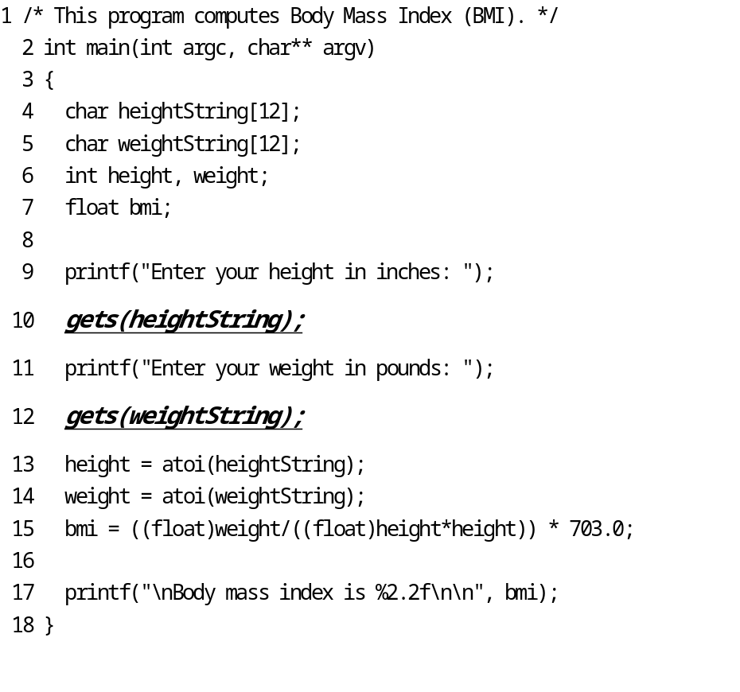
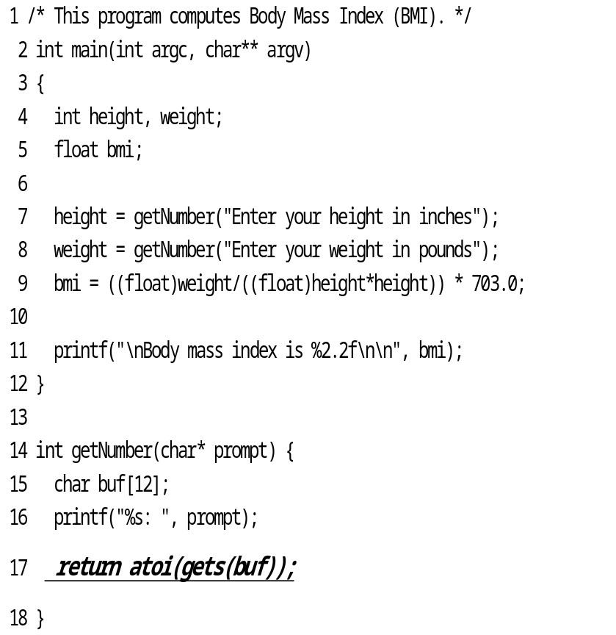
Density Deception
2/18 = 0.111
1/18 = 0.056

Slide 62
Metrics for Tactical Focus
Measuring vulnerability density
Comparing projects by severity
Breaking down results by category
Monitoring trends

Slide 63
Measuring Vulnerability Density
Static Analysis Results / Number of Lines of Code
  Not suitable for risk measurement
  Good for measuring the amount of work to do a complete review
Vulnerability Density across different modules or different projects
  Helps formulate review priorities
  Track issue density over time to get insight of consideration of tool output

Slide 64
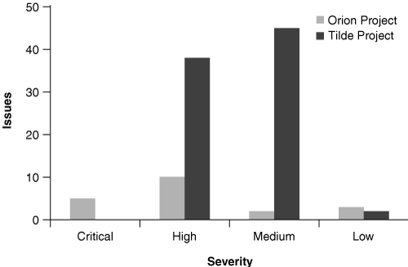
Source code analysis results broken down by severity for two subprojects
A plan of action: Check out the critical issues for the first module, and move to the high-severity issues for the second

Slide 65
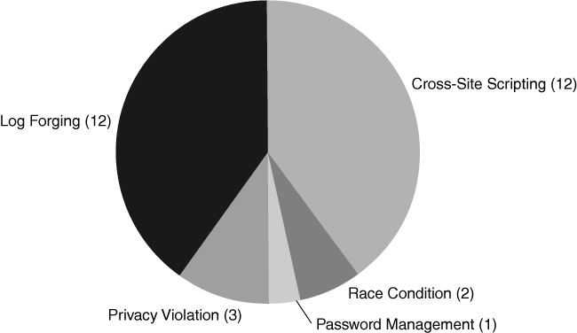
Source code analysis results broken down by category
Give a rough Idea about the a mount of remediation effort required to address each type of issue
Suggest that Log forging and cross-site scripting a god topics for an upcoming training class

Slide 66
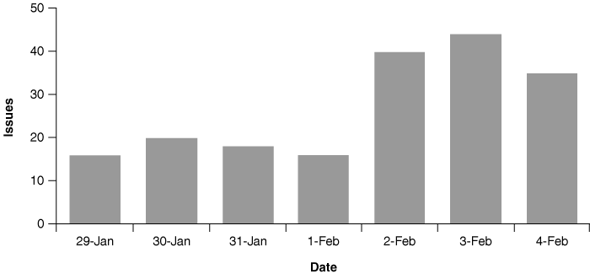
Nightly builds
Sharp increase of issues deserve attention
Feb-2 issues: just taken over a module from a group not focus on security

Slide 67
Process Metrics
Vulnerability Dwell
  After vulnerability identified, how long, on average, does it take for the programmers to make a fix
  Measure how long it remains in the code
Audit Coverage over time
  Rate of auditing keeps pace with the rate of development
Audit History
  Total number of static analysis results
  Number of reviewed results
  Number of identified vulnerabilities

Slide 68
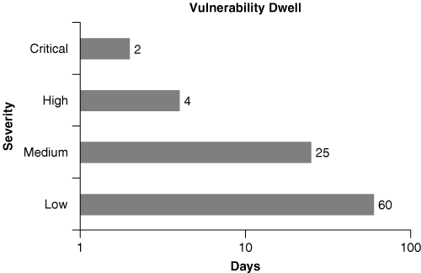
Vulnerability dwell as a function of severity
  After vulnerability identified, how long, on average, does it take for the programmers to make a fix
  Measure how long it remains in the code

Slide 69
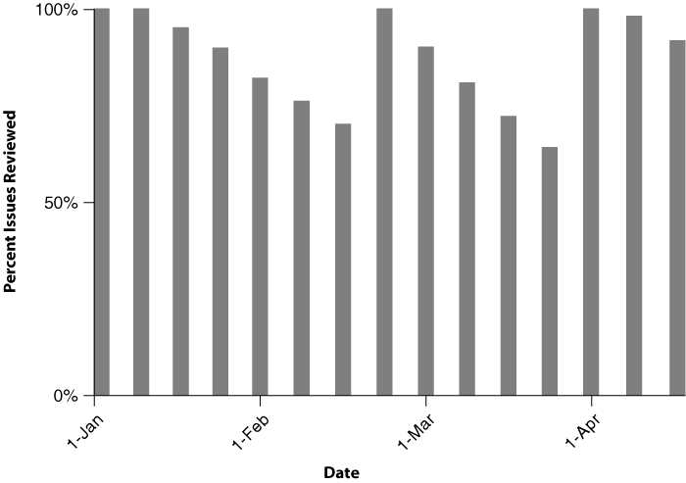
Audit coverage over time

Slide 70
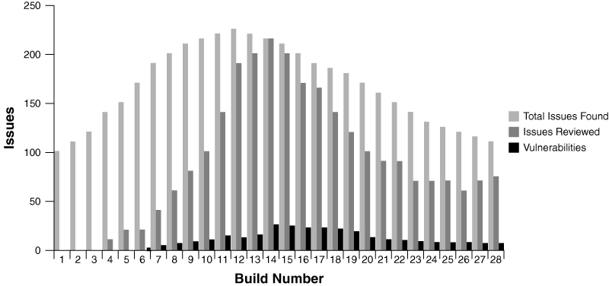
Audit History

Slide 71
Summary
Code Review Process
  Defining Goals, Running Tools, Reviewing Code, Making Fixes
  Ineffective Process
    Debate about Exploitability
Tool Adoption Plan
  Who will run, when they’ll run, what will happen to the results

